Slide 1


IRONS JUNIOR
HIGH SCHOOL
Course Selection
for 2021-2022
7th Grade

Slide 2
What to expect?
7 Periods = 7 teachers
50 minute classes
All classes meet every day
School day 8:50am - 4:08pm

Slide 3
CLASS SCHEDULE
7 Classes consisting of the following:
➔ Language Arts
➔ Math
➔ Science
➔ Social Studies
➔ Physical Education
➔ Elective (2 one semester electives or one full year elective
– Band, Orchestra or Choir)
➔ Elective (2 one semester electives)

Slide 4


ACADEMICS
Grades:
40% Daily grades
60% Major grades
Use of PLANNER is
important!!

Slide 5

WHAT IS A
HONORS COURSE?
HONORS courses prepare you to take Advanced Placement (AP) or Dual Credit courses in high school. AP courses can earn college credits (only offered in high school)
HONORS courses:
  More rigorous and complex
  Class may go in to more depth in learning
  Have more homework and projects done outside of
class time

Slide 6

WHO SHOULD TAKE A
HONORS CLASS?
Students who are:
Self Motivated
Manages time effectively
Willing to work outside of class time
on homework, projects, etc.
Students who have:
Recommended STAAR Scores, 80% or higher
85 or higher in current core subject area

Slide 7



Conroe Independent School District
Student and Parent Agreement for Enrollment in Advanced Courses Honors, AP, Dual Credit
CISD encourages all students to enroll in available advanced placement (AP) and Pre-AP classes to enhance their academic experience. Any CISD student may enroll
in Pre-AP or AP classes as his or her schedule permits.
AP courses differ from regular high school courses in that instructors use advanced curricula that is outlined by the College Board and authorized through the College Board’s audit process. Pre-AP courses focus skill development, habits of mind, and in-depth preparation in a subject area that is necessary to master the skills required to achieve success in AP courses. Other characteristics of advanced courses include content immersion, a fast pace, and assessment of performance at the analysis and synthesis levels.
While we expect students to be very successful in Honors, AP, or Dual Credit classes, a close look at the student’s total course load and commitments to other activities should be taken into deliberation when choosing how many of these courses to take during a semester. For some students, the best way to begin moving into these courses is by beginning with one, until they better understand the expectations and time commitments involved.
CISD strongly believes that , AP, and Dual Credit courses provide enhanced academic opportunities for students that will assist them in future academic or nonacademic pursuits. At the same time, the District recognizes that students may experience initial surprise or difficulty in managing the increased course requirements. A struggling student and his/her parent/legal guardian should schedule a conference with the teacher and counselor in order to create strategies to be implemented over a period of time. To ensure students allow sufficient time to become acclimated to the classes and what the Pre-AP and AP curriculum can offer, the District expects that any student who enrolls in a Pre-AP or AP class will remain in the course for the entire first semester. It is essential that the student give his/her maximum effort to succeed. At the end of the first semester, administration, the parents, teacher, and student may evaluate the student’s progress and make an adjustment to the student’s schedule. Any change will only be made on a space available basis.
Student Agreement
My signature below confirms that I am familiar with the expectations of the AP/Pre-AP/Dual Credit course and accept its academic challenges. I agree to devote my best efforts to successfully complete the course. I understand this class offers increased rigor and challenge and I agree to request help when I need it and to attend tutorials if I fall behind in class assignments or experience difficulty with course content. I understand that my success in this AP/Pre-AP course is primarily my responsibility. I understand and agree that I must remain enrolled in this class at least through the first semester.
Signature-Student Date Signed
Parent/Legal Guardian Agreement
Printed Name
My signature below confirms that I have read and am familiar with the course description and syllabus for the AP/Pre-AP/Dual Credit course. I understand that the course requires increased rigor and challenge and I agree to support and encourage my student to successfully complete this course. I will notify the teacher immediately of any concerns I have relating to the AP/Pre-AP/Dual Credit class or my student’s progress. I understand and agree that my student must remain enrolled in this course at least through the first semester.
Signature – Parent/Legal Guardian Printed Name Date Signed
Honors Agreement will be sent through Parent Access

Slide 8

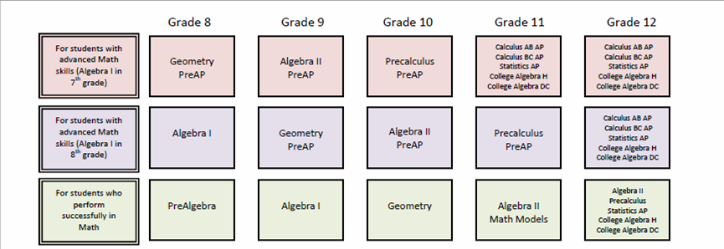
MATH COURSE PROGRESSIONS
Typical Course Selection Options for Math, Grades 7-12
Grade 7
Algebra 1 PreAP
Pre Algebra PreAP
7th Grade Math

Slide 9
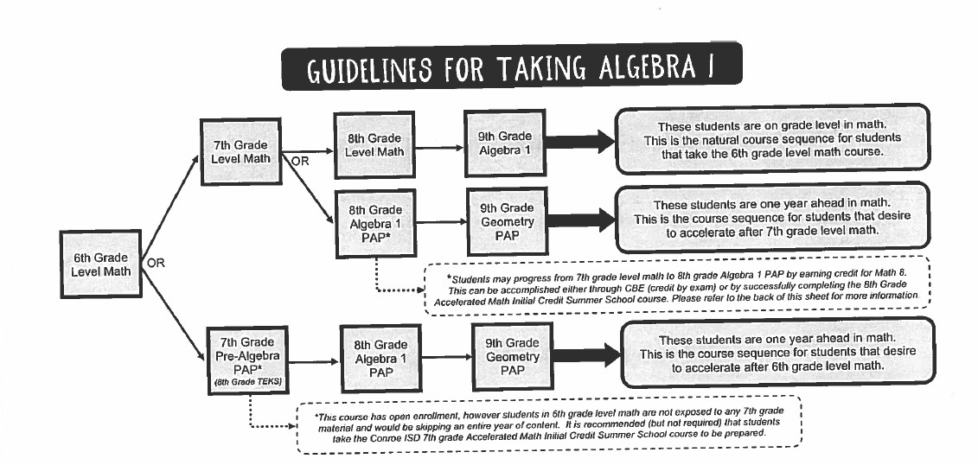
HONORS 7TH GRADE MATH
If the student is in 6th Grade level Math

Slide 10

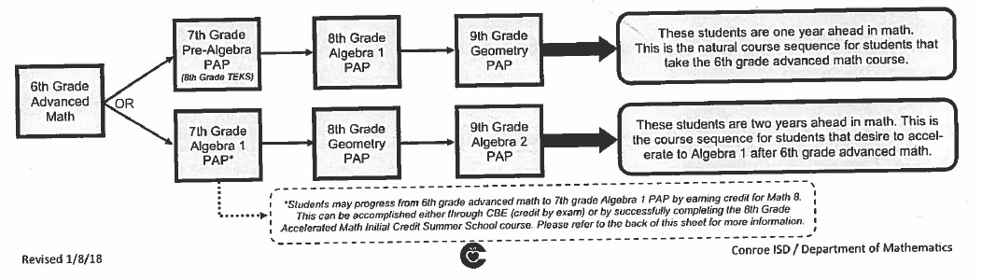
HONORS 7TH GRADE MATH
If the student is in 6th Grade Advanced Math

Slide 11
Conroe Independent School District
Program of Studies 2020-2021
Catalog of Courses can be found in the CISD Program of studies.
Not all courses in Catalog are offered at every school.
Available online only
Link: https://www.conroeisd.net/wp-content/uploads/2019/08/20-21-Program-of-Studies-Aug-21-2019.pdf

Slide 12




FULL YEAR ELECTIVES
BAND
ORCHESTRA
CHOIR
YEARBOOK-application required
TV Broadcasting-application required

Slide 13

1 SEMESTER ELECTIVES
Art I
Art II (Spring) pre-requisite Art 1
Computer Science I (keyboarding)
Human Services
Music Appreciation
Reading Enjoyment
Technology
Teen Leadership I
Theatre I
Wildlife Management

Slide 14



CHOOSING ELECTIVES
Students will get either:
  4 one semester electives (2 each semester) OR
  1 full year elective (Band, Orchestra or Choir)
and 2 one semester electives
Placement in electives is determined by choice,
availability and flexibility with other courses.
Electives will not be changed during the school year
CHOOSE WISELY!

Slide 15
STAAR ENRICHMENT
Students will be required to take a STAAR Enrichment Course if not successful on the STAAR test. NOT OPTIONAL

Slide 16






ATHLETICS
FALL SPORTS
Volleyball
Football
Cross Country
Basketball
SPRING SPORTS
Track
Soccer
Tennis
Golf
A Physical is required
to participate in Athletics
Athletics is a full year course

Slide 17



ATHLETICS CLASS
GIRLS ATHLETIC CLASS
BOYS ATHLETIC CLASS
  Football ONLY in the Fall
  Cross Country meets in the morning & don’t need to be in Athletics but WILL need a physical on file
All other sports practice before or after school and do not require students
being enrolled in Athletics Class

Slide 18
Off-Campus PE
The purpose of the Off-Campus Physical Education Program is to accommodate students who are making a serious effort to develop high- level skills in a specific activity that exceeds what the school district can offer through general PE programs.
Facility is to be in a partnership with Conroe ISD.
Category 1- Participation includes a minimum of 15 hours per week. Student is dismissed early to participate in Off-Campus PE program.
Category 2- Participation includes a minimum of 5 hours per week. Student is NOT dismissed early and will receive PE credit from Off- Campus program. Student will not participate in PE at Irons rather have another elective in its place.
Deadline for enrollment to Off Campus PE Program is May 1st.
Refer to following link for more information https://apps.conroeisd.net/physedoffsite/

Slide 19
CHEERLEADING
DRILL TEAM
Cheerleading and Drill Team are offered for PE Credit
Students who try out and make the squads will be placed in the appropriate class based on a list from the sponsors
See your counselor if you are interested in both
Cheer or Drill and Athletics
Check Irons website for information about Try-Outs https://kneal3.wixsite.com/cheer

Slide 20
Entering in your courses
1. Login into SSO
2. Click on ViewIT
3. Click on Student Plan
4. Click on JHS Requests

Slide 21
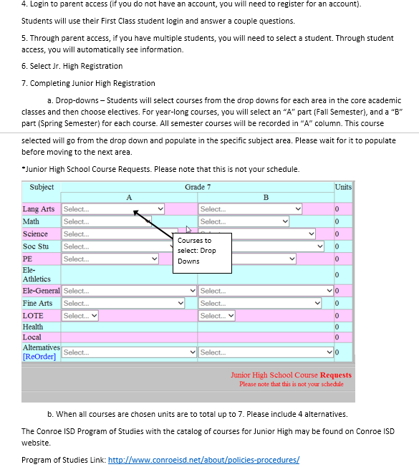

Slide 22
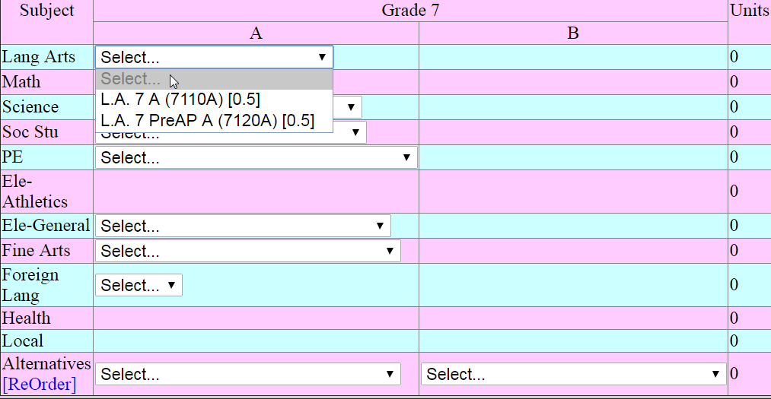

Time to pick your 7th grade classes…
You will have the option to choose Level or Honors for
Language Arts, Science and Social Studies.

Slide 23
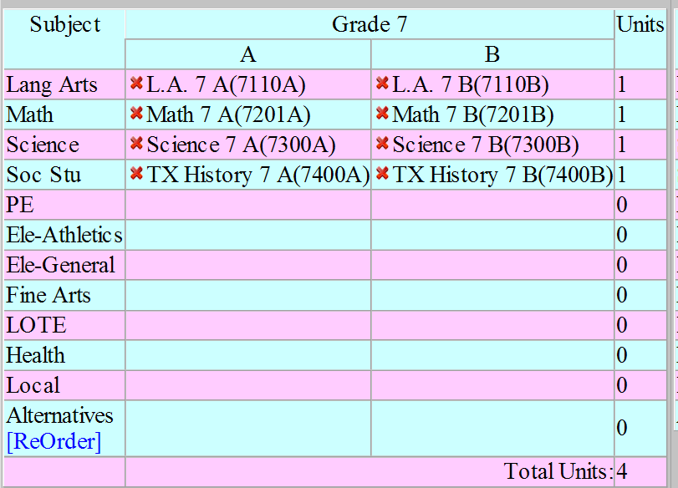
Sample CORE Classes
You may choose Pre-AP or Level.
A Semester=Fall
B Semester=Spring

Slide 24

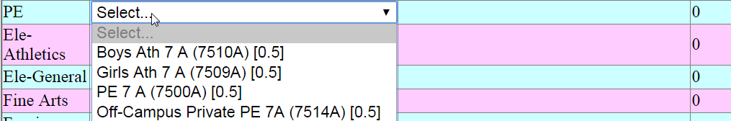
Physical Education
All students will need to dress out in PE and Athletics. Uniforms may be purchased through the school webstore.
Athletic students MUST have a physical on file by the first week of school. Athletics information may be found here. http://www.conroeisd.net/department/athletics/
Off-Campus PE application deadline May 1st. https://apps.conroeisd.net/physedoffsite/

Slide 25
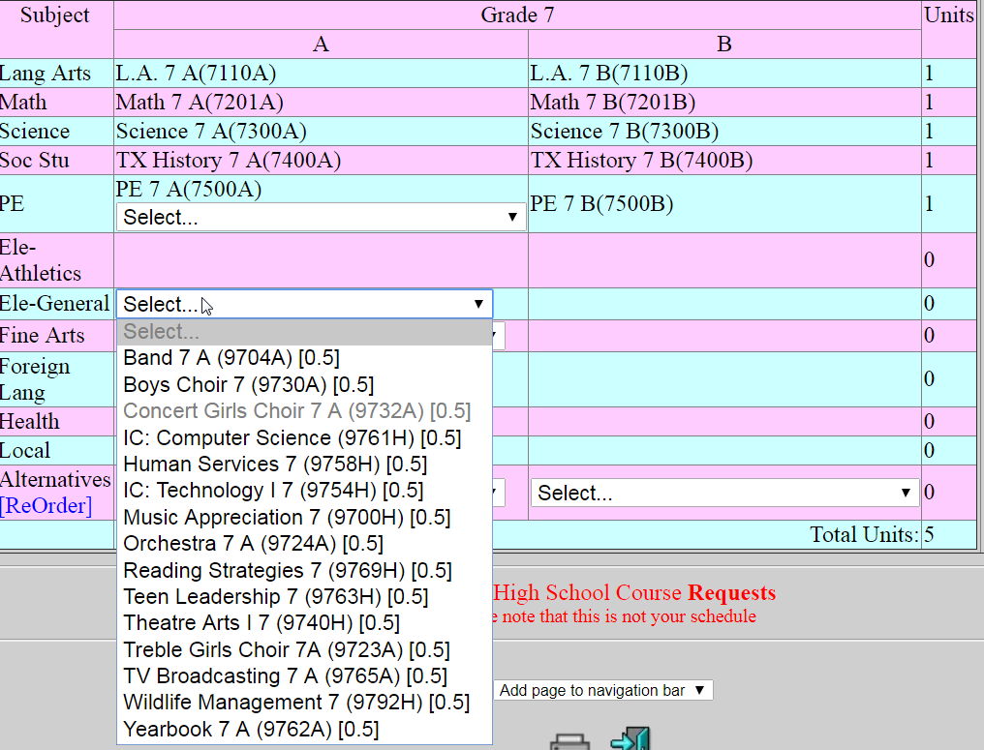
Electives
Note: Courses with an “H” are only one semester.
Courses with an “A” “B” are full year

Slide 26
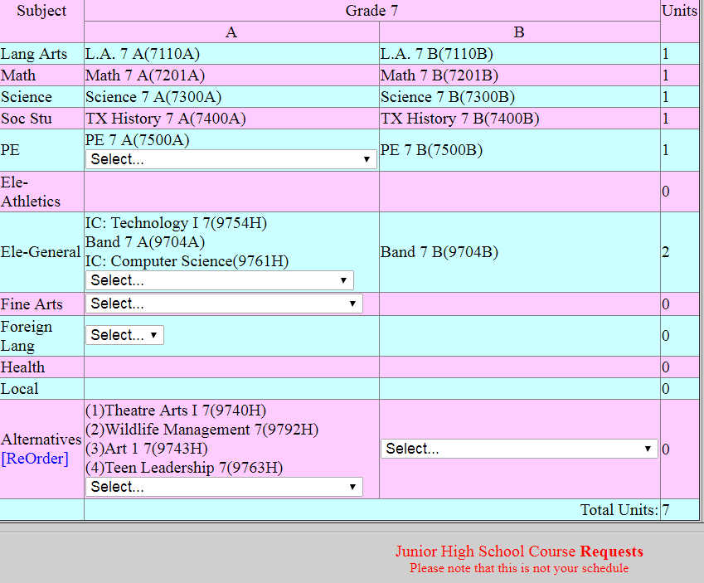
Alternates- Pick only 4 alternate courses, in case there is a conflict with your other elective choices.

Slide 27
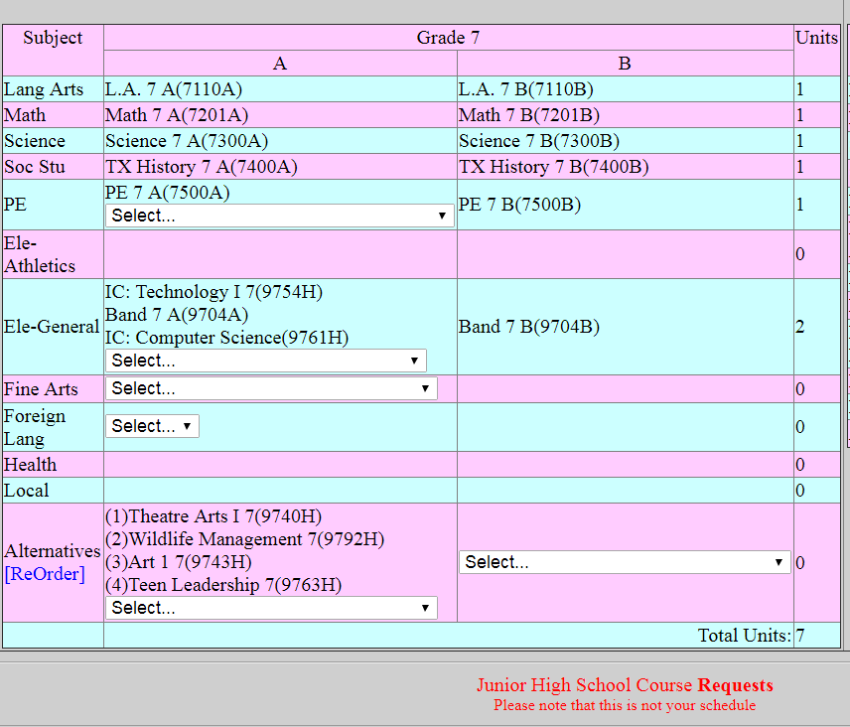
Sample Course Request 7th Grade
How do I know if it is complete?
A total of 7 units.
4 Alternate courses on the “A” side only

Slide 28
7TH GRADE
REGISTRATION WILL
CLOSE ON
FEBRUARY 12th!

Slide 29
COURSE VERIFICATIONS
Students will receive a Course Verification Sheet during the 4th nine weeks showing what courses they chose for next year.
Any corrections to course selections can be made before May 5th

Slide 30
SCHEDULE CHANGES
Schedule changes must be received in writing with a parent signature.
Level changes will be made during the first 6
weeks of the school year only.
No elective changes after May 5, 2021
MAY 5th is DEADLINE FOR SCHEDULE CHANGES

Slide 31
SCHOOL GUIDELINES
Dress Code
  School is a place of business, and dress code regulations will provide appropriate standards for the general appearance of students.
Attendance
  Students must be in attendance 90% of the year
  Credit can be lost if excessive absences
  Academic Success is directly impacted by attendance
Tardies
  It is very important to the educational process that students arrive to school and to each of their classes on time each school day.
  Tardiness is defined as arriving to class late without an approved pass
from a teacher or administrator.
Complete list of guidelines can be found on Irons Jr. High Student Handbook Supplement

Slide 32
Cell Phones/electronic
Electronic Devices
No electronic devices are permitted during school hours.
  If a student brings electronic devices he or she does so at his or her own risk. We are not responsible for lost/stolen items. If a student does have an electronic device, it should be put away in a secured locker and turned off
during the school day. Permission to use the device at school should come from administration or the teacher when it is being used to enhance classroom instruction.
  Without such permission, teachers will collect the items and turn them in to
the front office for parent pick up.
  A phone call will be made to notify the parent that a phone or electronic item was collected.
  Phone/electronics will only be returned to parent/legal guardian.
Irons Jr. High Student Handbook Supplement

Slide 33
Social Media
Five reminders for your kids
If you're opening a conversation with teenagers and those who are almost teens — about what's appropriate online and what's not, researcher Poco Donna Kernsmith of Wayne State University in Detroit suggests these five points.
Remember nothing is private online
Remember nothing online can be taken back
Be aware of pressure and coercion
Consider the reaction and feelings of others
Remember nothing is truly anonymous
Monitor, monitor, monitor!
Secondary Handbook page 44

Slide 34

WE ARE
Hawk Nation

